Slide 1






The Future of OpenAI and LLMs
Xavier Morera
Helping developers create epic applications
www.xaviermorera.com / www.bigdatainc.org / www.lupo.ai

Slide 2

The world is changing in front of our eyes

Slide 3

LLMs are here to perform a whole series of tasks close to human level.
Things that used to take a lot of time can now be done in a few moments with outstanding results.

Slide 4

All Types of Applications
Content Generation, Language Translation, Code Generation, Text Summarization, Question Answering, Personal Assistants, Content Recommendations, Therapeutic Chatbots, Education and Tutoring, Creative Writing Assistance, Language Learning, Simulations and Games, Legal and Compliance Assistance, Data Extraction, Accessibility...

Slide 5

@openAI
Research v
API v
ChatGPT v
Safety
Company v
Search
Log in .71
I Try ChatGPT .71 I
OpenAI API
We're releasing an API for accessing new Al models developed by OpenAI.
I Sign up .71 I
Explore the API

Slide 6


Ethical Considerations
Bias and fairness
Privacy
Misinformation and disinformation
Content moderation

Slide 7
Ethical Considerations
Consent
Intellectual property
Job displacement
Security

Slide 8
Ethical Considerations
Deepfake detection
Accountability and transparency
Environmental impact
Regulatory compliance

Slide 9
Ethical Considerations
Ethical AI research
Accessibility
Multidisciplinary approach
Ongoing effort

Slide 10
Exploring Open Challenges

Slide 11
Challenge
Navigating the complexities of human communication.

Slide 12
Addressing bias detection and mitigation becomes imperative as AI language models become more integrated into daily interactions.

Slide 13
Challenge
The diversity of languages and cultures worldwide poses a significant challenge for AI models.

Slide 14
Challenge
The language landscape is dynamic, with constantly evolving trends, expressions, and language use.

Slide 15
Personalization is a cornerstone of AI interaction, allowing models to tailor responses to individual preferences.

Slide 16
Real-time AI interactions are a frontier that holds the promise of seamless communication.

Slide 17
The Future with NLP

Slide 18

AI Models Redefine
Healthcare
Education
Entertainment

Slide 19

NLP can swiftly analyze vast text corpora

Slide 20
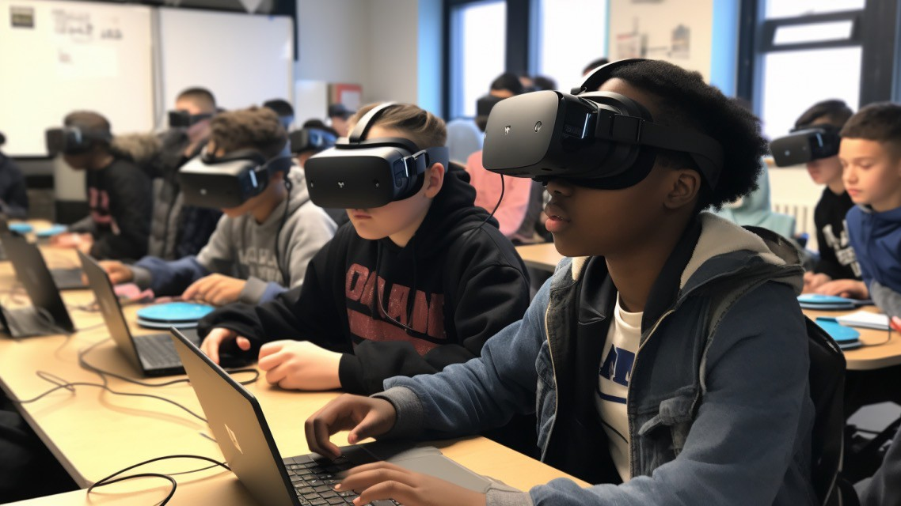
Personalized learning experiences

Slide 21

Custom-tailored immersive narratives

Slide 22

Industries are being revolutionized

Slide 23




@ Overview
Documentation
API reference
Examples
Playground
Fine-tuning
Q) Forum
0) Help
Lupo.ai
I
[0 Search
CTRL K
Overview
GET STARTED
The OpenAI APII is powered by a diverse set of models with different capabilities and price points. You can also make customizations to our models for your specific use case with fine-tuning.
Introduction
Quickstart
MODELS
DESCRIPTION
Libraries
GPT-4
A set of models that improve on ¹GPT-3.5 and can understand as well as generate natural language or code
Models
Overview
GPT-3.5
A set of models that improve on ¹GPT-3 and can understand as well as generate natural language or code
Model updates
GPT-4
GPTbase
A set of models without instruction following that can understand as well as generate natural language or code
GPT-3.5
DALL·E
DALL·E
A model that can generate and edit im1ag1es given a natural language prompt
Whisper
Whisper
A model that can convert audio into text
Embeddings
Moderation
Embeddings
A set of models that can convert text into a numerical form
GPT-3
Moderation
A fine-tuned model that can detect whether text may be sensitive or unsafe
How we use your data
GPT-3 Legacy
A set of models that can understand and generate natural language
Endpoint compatibility
Deprecations
Deprecated
A full list of models that have been deprecated
u " h
f"'I ID

Slide 24

jUpyter chatbot-conversation Last Checkpoint: 22 hours ago
•
File Edit
View Run Kernel
I[] L] ► ■
Settings Help Trusted
C ►► Code
B +
V
Jupyterlab [J O
Python 3 (ipykernel) 0
Chatbot
Creating1a basic chatbot wilth the OpenAI API that keeps the conversation going
I
[ ] : # !pip install openai
[ ]:
import opena1 import os import json
[]: key_location = ¹/Users/xavier/github/xmorera/ps-generative-ai-developing-applications-python-openai/key/genaikey.txt'
with open(key_location, 'r'} as file: key= file.readline().strip()
[ ]: openai.api key = key
_
[ ]: chat_messages = []
[ ]: def process_chat_request(prompt}:
111111_{Make a API}111111
request to the OpenAI
chat_mes sages. append ({¹¹ role": ¹¹ user¹¹, ¹¹content":
prompt})
response= openai.ChatCompletion.create( model=¹¹gpt-3.5-turbo¹¹,
messages= chat_messages,
temperature=0.7
}
# Append the response to messages

Slide 25
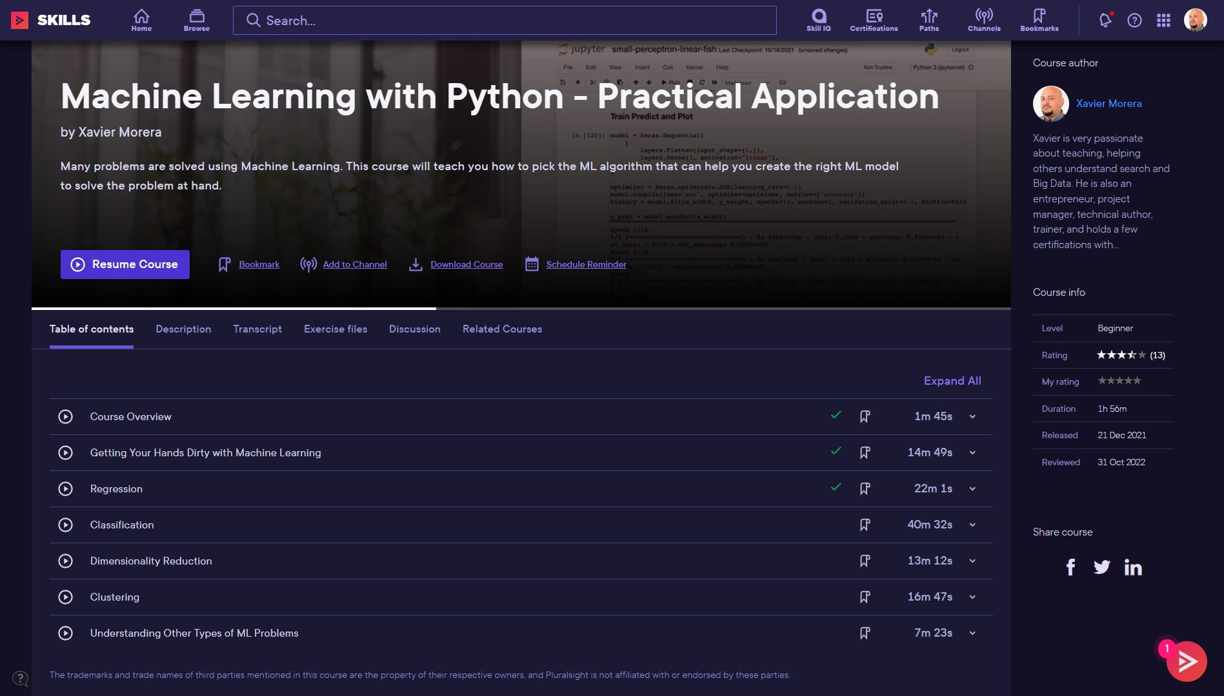

Slide 26
Thank You... And Welcome to the Future

Slide 27

Thanks for watching!
“What you learn is yours for life.”
Xavier Morera
www.lupo.ai / www.bigdatainc.org / www.xaviermorera.com

